Slide 1
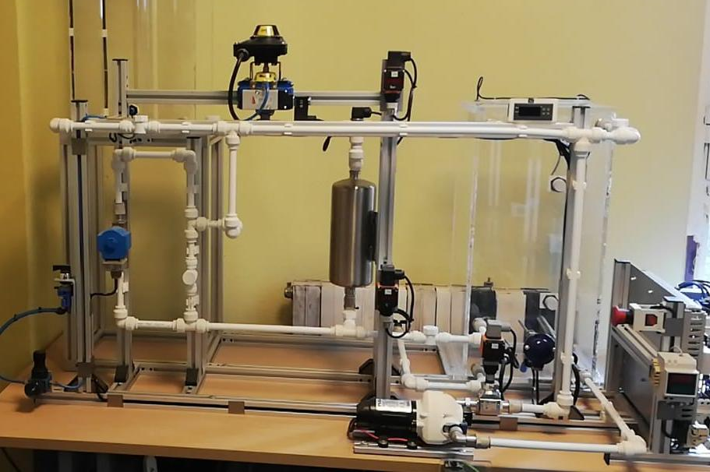
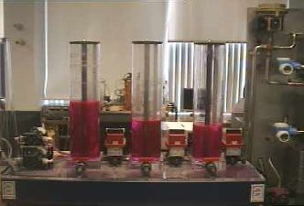
Provider
Lab
Reservation
Proxy
IdP
$LAB
Wallet
SSO
Decentralized back-end (blockchain)
Lab 1
…
Lab n
Blockchain services
Bookings
Lab Computer 1
Marketplace
Lab
Gateway
.
Lab setup 1
.
.
Lab Computer k
Lab provider infrastructure
Lab setup k

Slide 2
Wallet access
Provider
Lab
Reservation
Proxy
wallet add
add
add:timestamp
lab, booking
wallet, signed
$LAB
Wallet
Decentralized back-end (blockchain)
Lab 1
…
Lab n
Blockchain services
jwt
Bookings
Lab Computer 1
Marketplace
jwt
Lab
Gateway
.
Lab setup 1
.
.
Lab Computer k
Lab provider infrastructure
Lab setup k

Slide 3
Institutional (SSO) access
Provider
Lab
Reservation
Proxy
SAML assertion
IdP
SAML
resp
SAML
resp
SAML
assertion
userid, aff
lab, booking
$LAB
SSO
access request
Decentralized back-end (blockchain)
Lab 1
…
Lab n
Blockchain services
jwt
Bookings
Lab Computer 1
Marketplace
jwt
Lab
Gateway
.
Lab setup 1
.
.
Lab Computer k
Lab provider infrastructure
Lab setup k

